Slide 1
Origin of the p-Nuclei?
An interdisciplinary quest:
combining stellar modeling, nuclear physics, cosmochemistry, and GCE
T. Rauscher, N. Dauphas, I. Dillmann, C. Fröhlich, Zs. Fülöp, Gy. Gyurky
Rep. Prog. Phys. 76 (2013) 066201

Slide 2
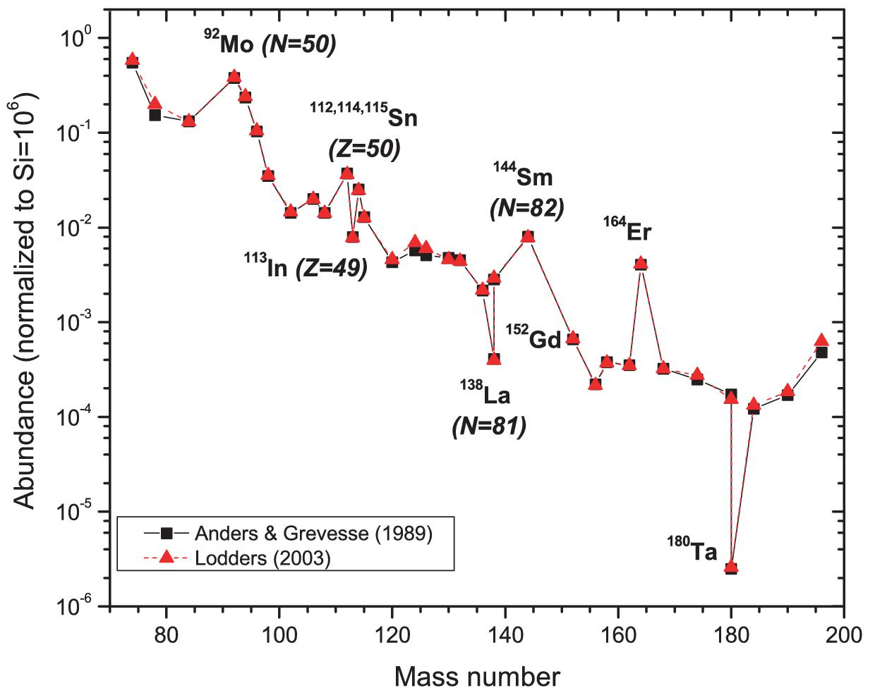
p-Nuclei
Def.: “What is not made by s- and r-process”
Originally 35 proton-rich nuclei assigned but:
“time-dependent” definition
perhaps fewer (s: ¹¹³In, ¹¹⁵Sn?, ¹⁵²Gd, ¹⁶⁴Er, …)
p-
Tiny abundances, no element dominated by p-abundance → no stellar abundances
Tiny reaction cross sections
“Few” nuclei involved, but also only few simulations and measurements (astron, nuclear) available

Slide 3
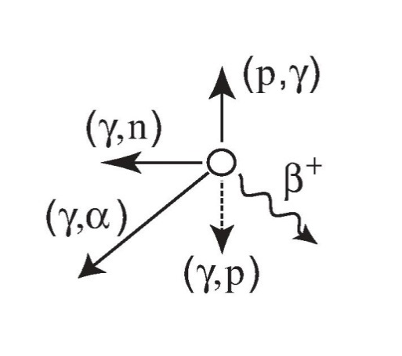
“p-Process”
Def.: “What makes the p-Nuclei”
One or several “manifestations”?
Possibilities to get to the proton-rich side:
From “below”: proton captures
hindered by Coulomb barrier, competition with photodisintegration
high proton densities required
From “above”: (γ,p), (γ,α), decay
From neutron-richer nuclei: (γ,n)
favored in photodisintegration of near-stable nuclei
What can be varied?
Proton abundance/density
Explosive conditions (temperature-density history)
Seed nuclei! (secondary process)

Slide 4
Popular Scenarios
Currently favored: γ-process in O/Ne shell of massive stars
consistent p-production across large range of nuclei
deficiencies for A<100 and 150<A<165
additional ν-process for ¹³⁸La and ¹⁸⁰Ta
Explosion of mass-accreting white dwarf
“regular” SN Ia and/or sub-Chandrasekhar WD
combination of p-captures and γ-process (and np-process)
Problems: requires seed enhancement, sensitive to details of the hydrodynamics
Extremely p-rich scenarios: rp-process, νp-process
decay of p-rich progenitors
problem: detailed modelling, ejection, Nb/Mo ratio in meteorites puts tight constraint

Slide 5
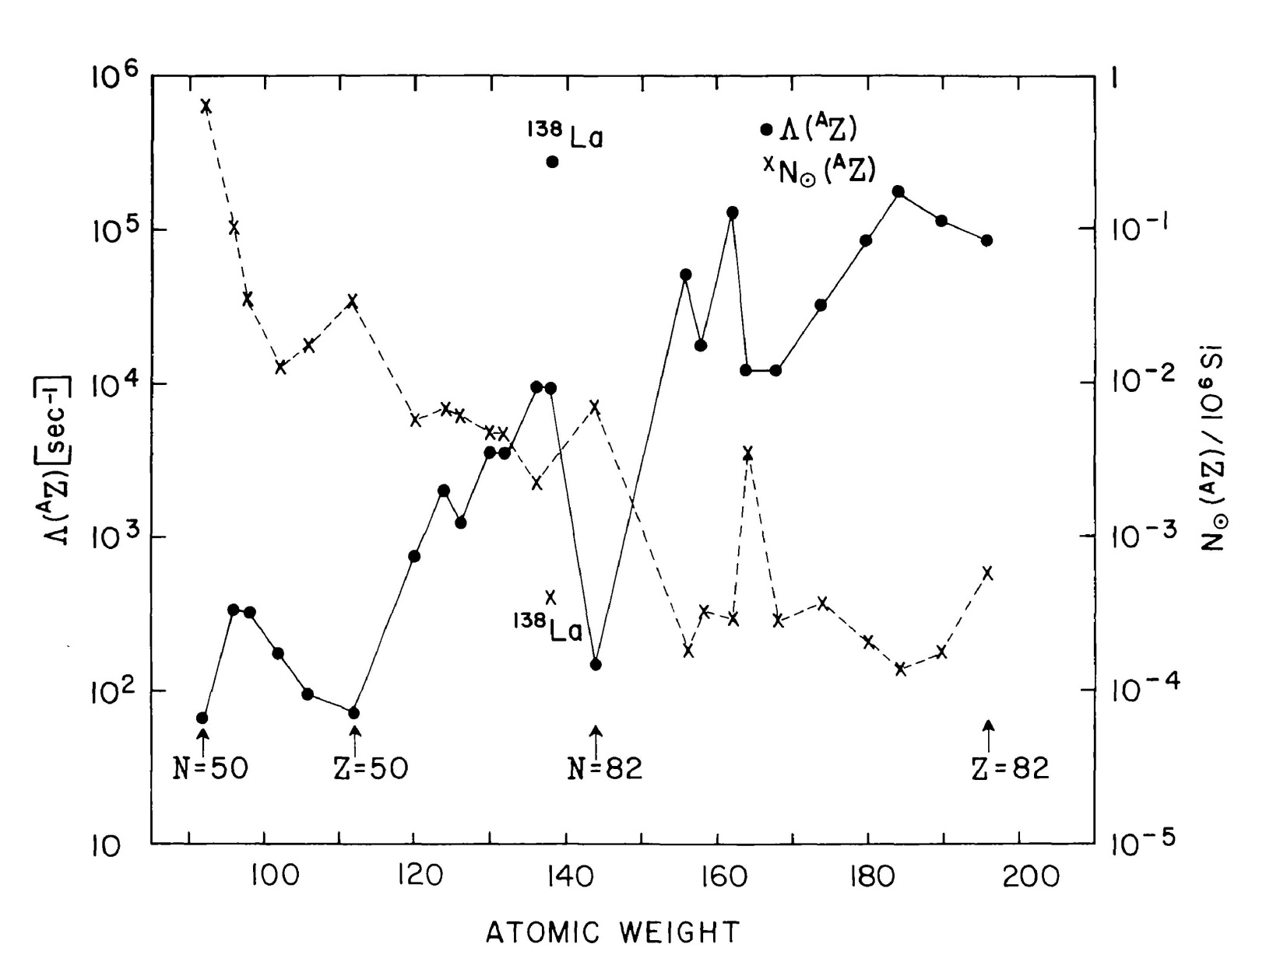
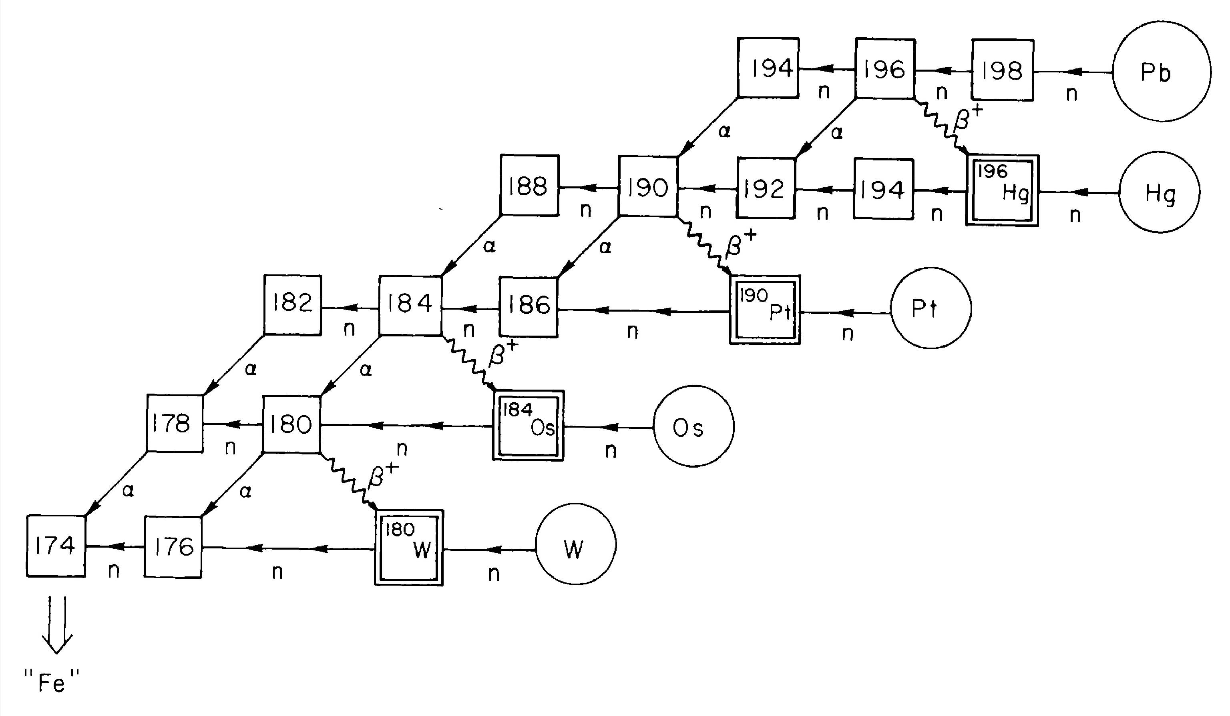
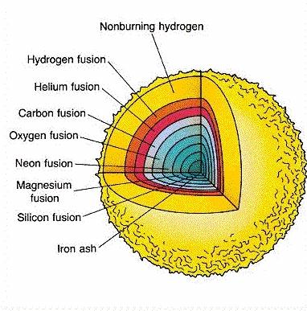
The γ-Process
Photodisintegration of seed nuclei (produced in situ or inherited from prestellar cloud).
NOT total disintegration, of course! (just the right amount)
Explosive burning in O/Ne shell in core-collapse SN
Woosley & Howard 1978; Prantzos et al 1990; Rayet et al 1995

Slide 6
The γ-Process
Photodisintegration of seed nuclei (produced in situ or inherited from prestellar cloud).
NOT total disintegration, of course! (just the right amount)
Explosive burning in O/Ne shell in core-collapse SN
Woosley & Howard 1978; Prantzos et al 1990; Rayet et al 1995

Slide 7
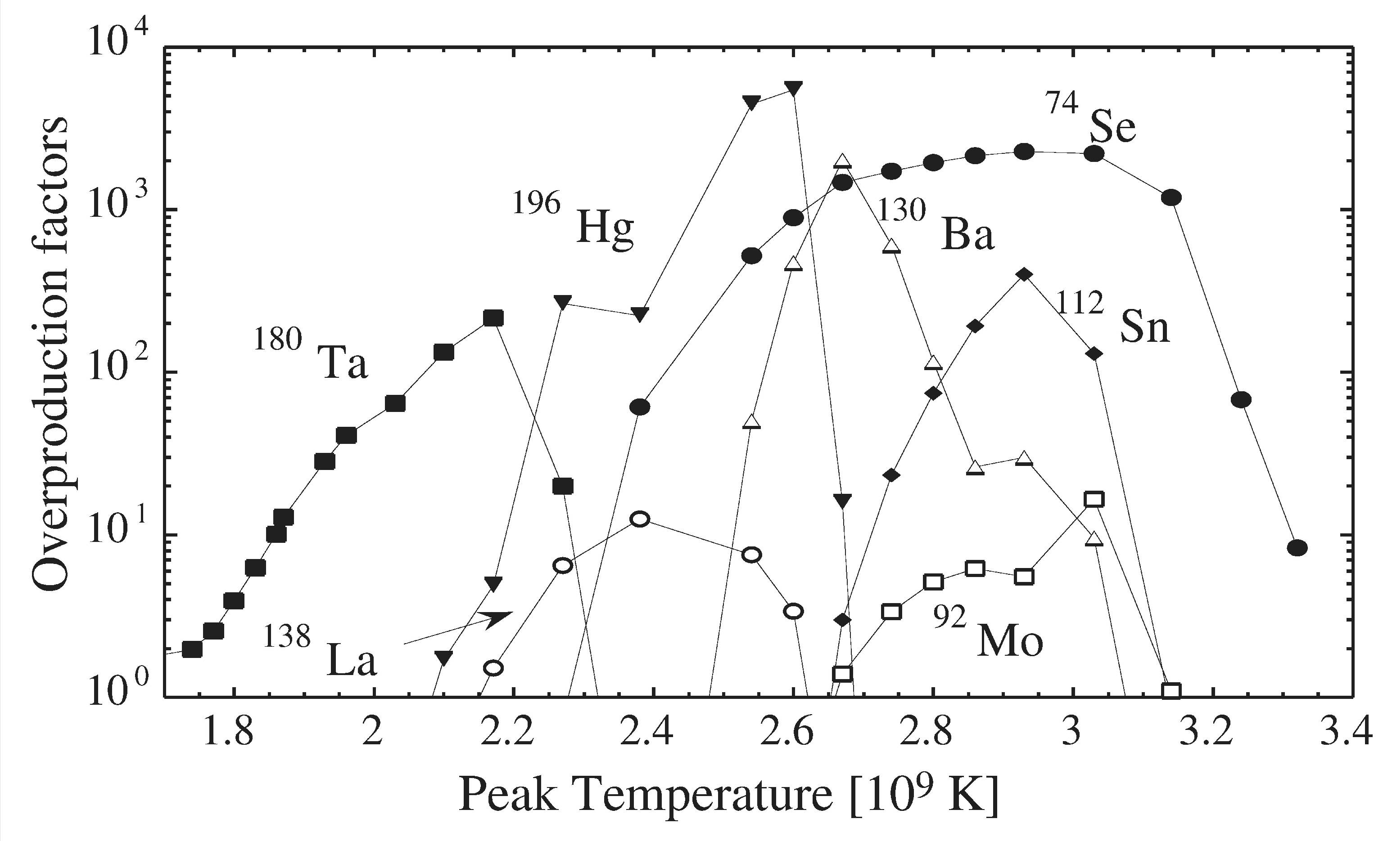
Nuclear Reactions Under γ-Process Conditions
Time-dependent density and temperature profile (self-consistent or parameterized)
Different layers with different peak temperatures: “light” p-elements produced at high temperatures, heavy at low ones
Temperatures similar in other scenarios
(not too much photodisintegration allowed!)

Slide 8
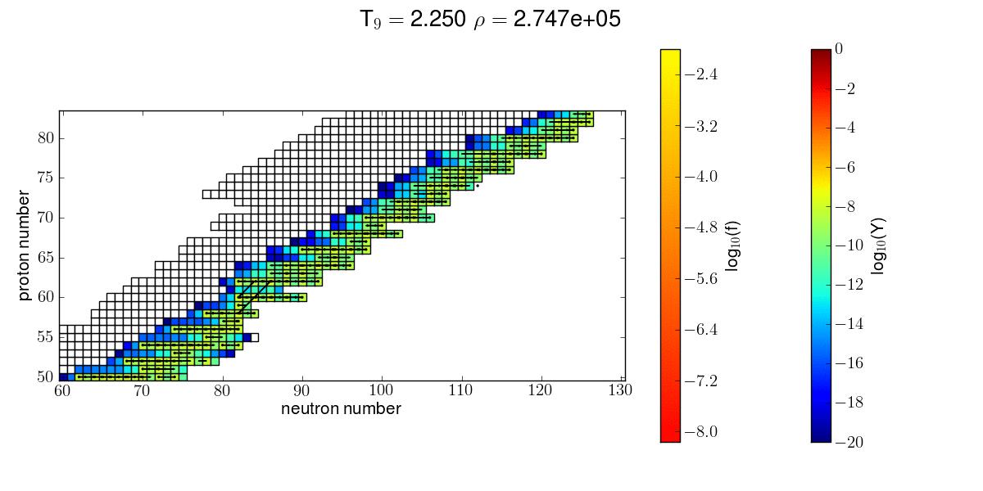
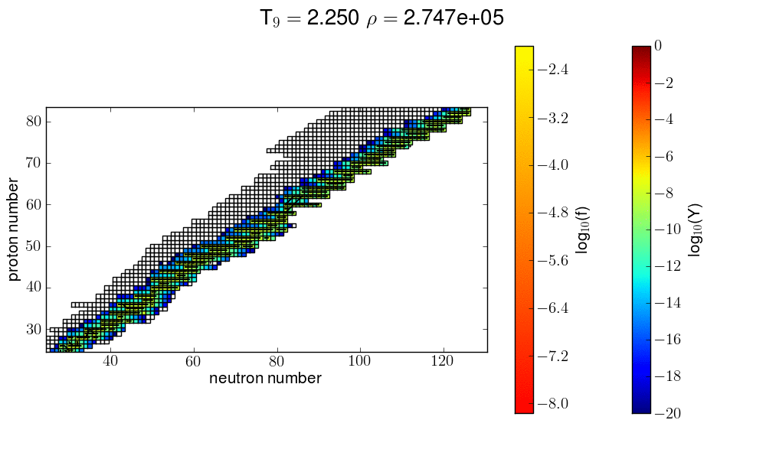
Photodisintegration of stable seed nuclei
Not an equilibrium process!
Competition of (γ,n), (γ,p), (γ,α) rates determine path and destruction speed at each temperature.
Strong nuclear constraints on required astrophysical conditions for each group of nuclei,
e.g., at high T all heavier nuclei are destroyed.

Slide 9
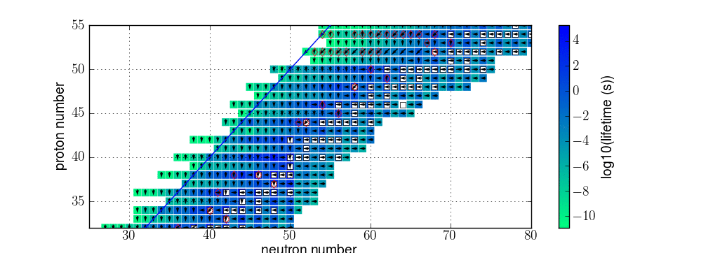
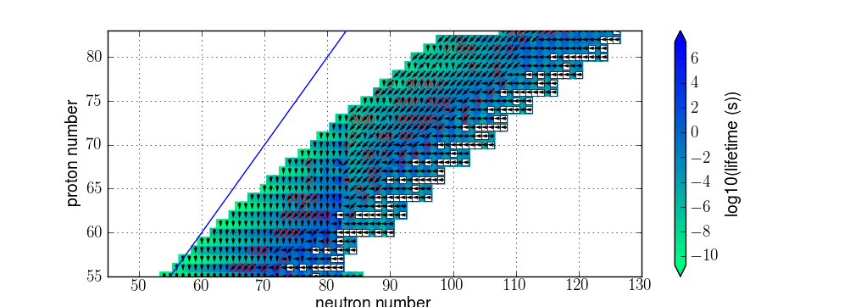
Example of Reactivity Field
low Z
(γ,p)/(γ,n) competition important at low Z
(γ,α)/(γ,n) competition important at high Z
(γ,α) uncertain because of uncertain optical potential at low energy
only first uncertainty in each isotopic chain (coming from stability) is relevant!!
Uncertainties:
diamonds: rate competitions
high Z

Slide 10
Nucleosynthesis Results (15 M_{sol})
Production factor
A
Rauscher et al. 2002

Slide 11
p-Production in Massive Stars
Site: Explosive O-shell burning in core collapse SN
Seed: s- and r-nuclides, either already existing when star formed or produced (weak s-process) during stellar life
Underproduction of Mo-Ru region always found (no sufficient seed abundance to disintegrate)
Dillmann, Rauscher et al 2008
KADONIS v0.2
Woosley & Howard ‘78

Slide 12
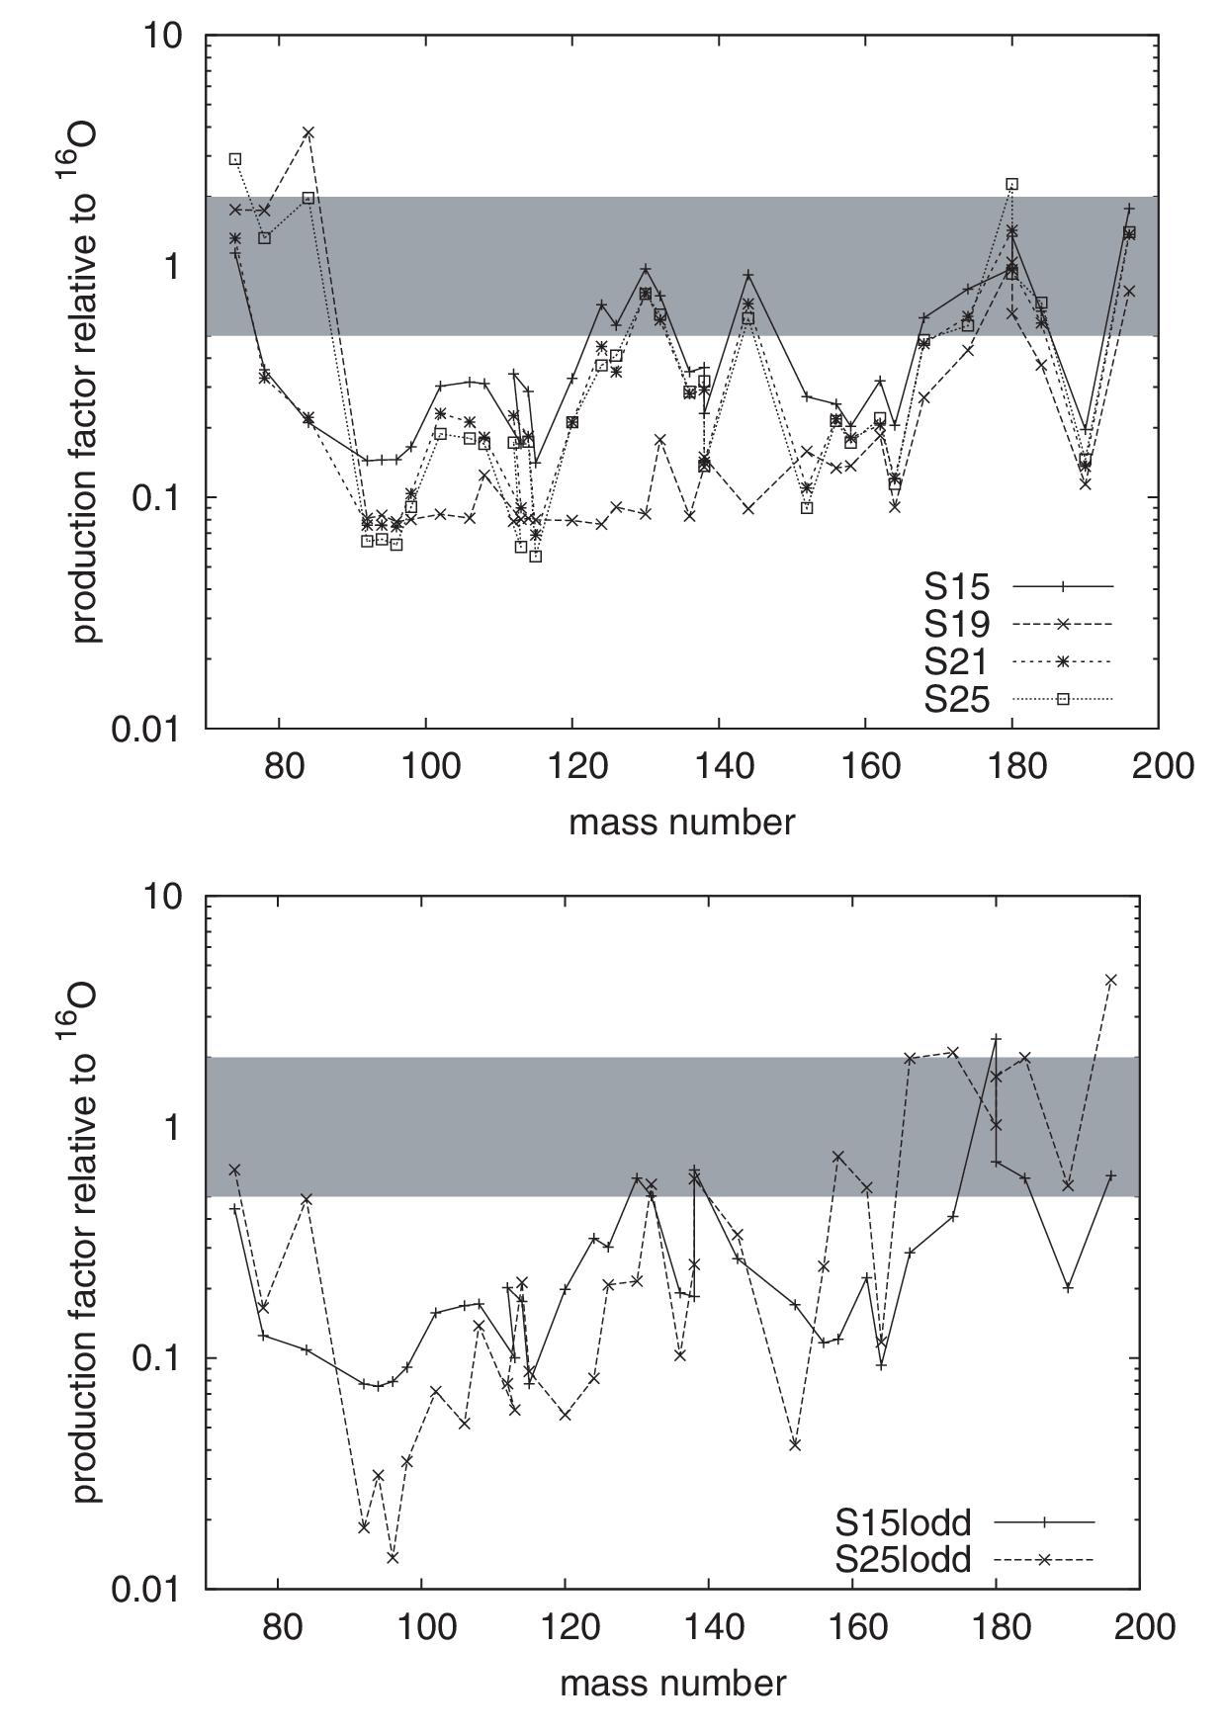
p-Production in various stellar models
Depends on progenitor mass
Depends on initial metallicity
Already new Lodders abundances lead to some differences
due to big 16O differences
and different pre-SN evolution (mostly in He-burning)
Rep. Prog. Phys. 76 (2013) 066201
Rauscher et al 2002

Slide 13
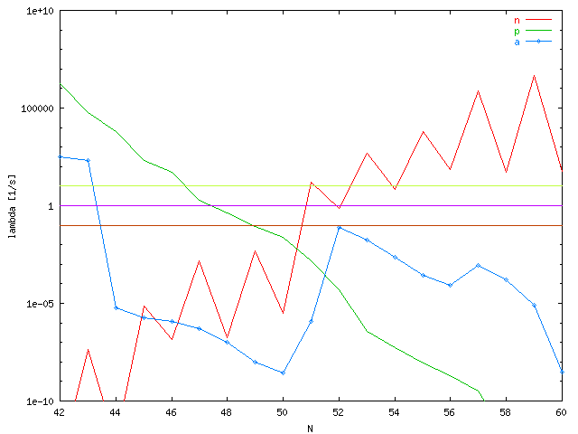
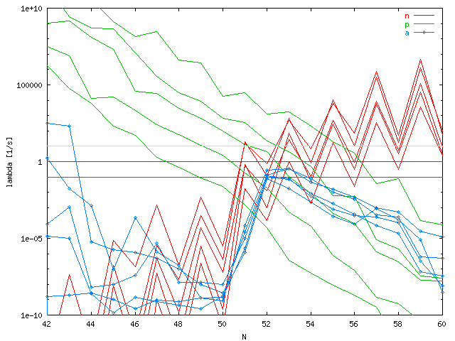
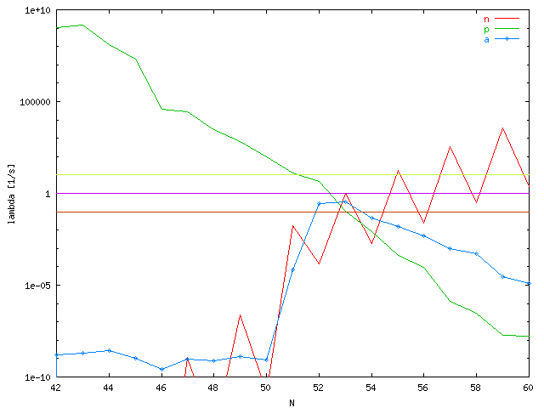
γ-Process Path Deflections
deflection
point
(γ,n) determine timescale
(γ,p/α) determine flow to lower mass
Mo
quick change in dominating reaction within isotopic chain
mostly only competition between (γ,n) and one other particle channel
primary targets for experimental investigation (but unstable!)
Pd
(γ,n), (γ,p), (γ,α) rates at T₉=2.5 for Z=42-46 (Mo-Pd)

Slide 14
Relevant Nuclear Input
General p-Process Properties:
Temperatures of 2<T₉<3.5 (depending on scenario)
Starting from s- and r-nuclides (previously included in star or produced by star), dominant flows are (γ,n)
With decreasing proton- and/or α-separation energy, (γ,p) and (γ,α) become faster: deflection of path (“branching”)
For “light” p-elements, (n,γ) can hinder efficient photodisintegration
(n,p) reactions can speed up matter flow
Some scenarios: proton captures in mass region of light p-nuclei
Rapp et al 2006

Slide 15
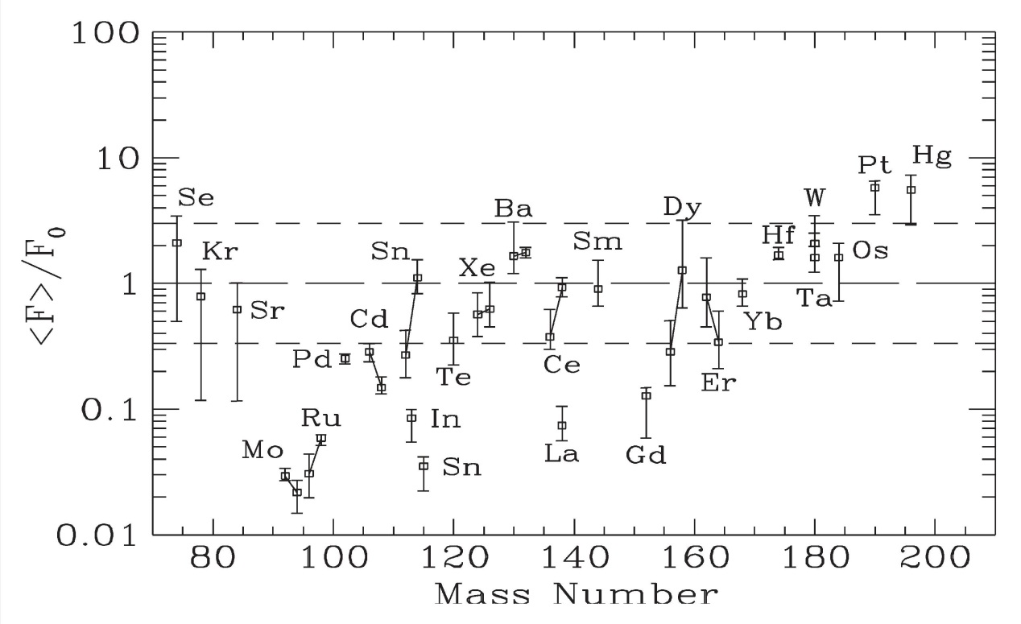
Galactic p-Evolution
p-Abundances result from many events: Have to integrate stellar yields over IMF (initial mass function, mass distribution of stars in galaxy)
Additional uncertainty…
Here, yields from stars with different masses but same (solar) metallicity are shown.
Arnould & Goriely ‘06

Slide 16
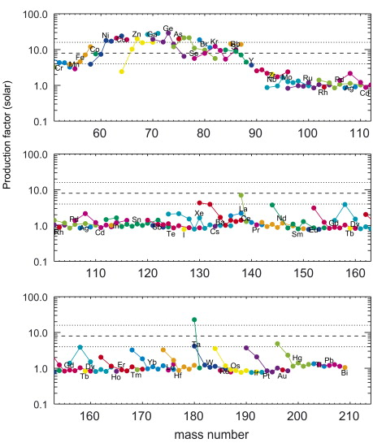
A & G 2003
Massive star yields averaged over IMF
(Lodders abundances)
p-Underproduction for A<130
still some problems at higher masses
Woosley & Heger 2007

Slide 17
Popular Scenarios
Currently “best” studied: γ-process in O/Ne shell of massive stars
consistent p-production across large range of nuclei
deficiencies for A<100 and 150<A<165
additional ν-process for ¹³⁸La and ¹⁸⁰Ta
Explosion of mass-accreting white dwarf
“regular” SN Ia and/or sub-Chandrasekhar WD
combination of p-captures and γ-process (and np-process)
Problems: requires seed enhancement, sensitive to details of the hydrodynamics
Extremely p-rich scenarios: rp-process, νp-process
decay of p-rich progenitors
problem: detailed modelling, ejection, Nb/Mo ratio in meteorites puts tight constraint

Slide 18
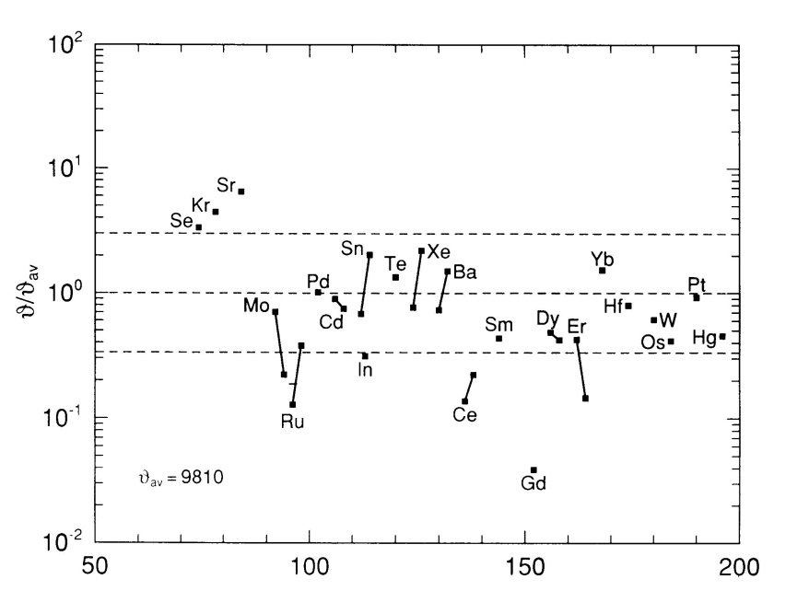
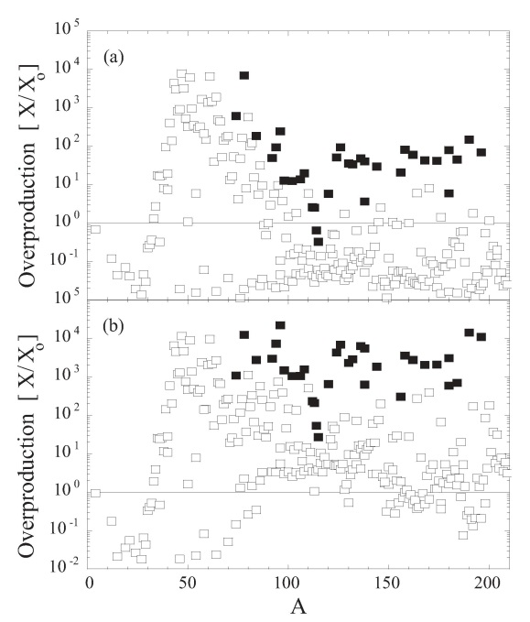
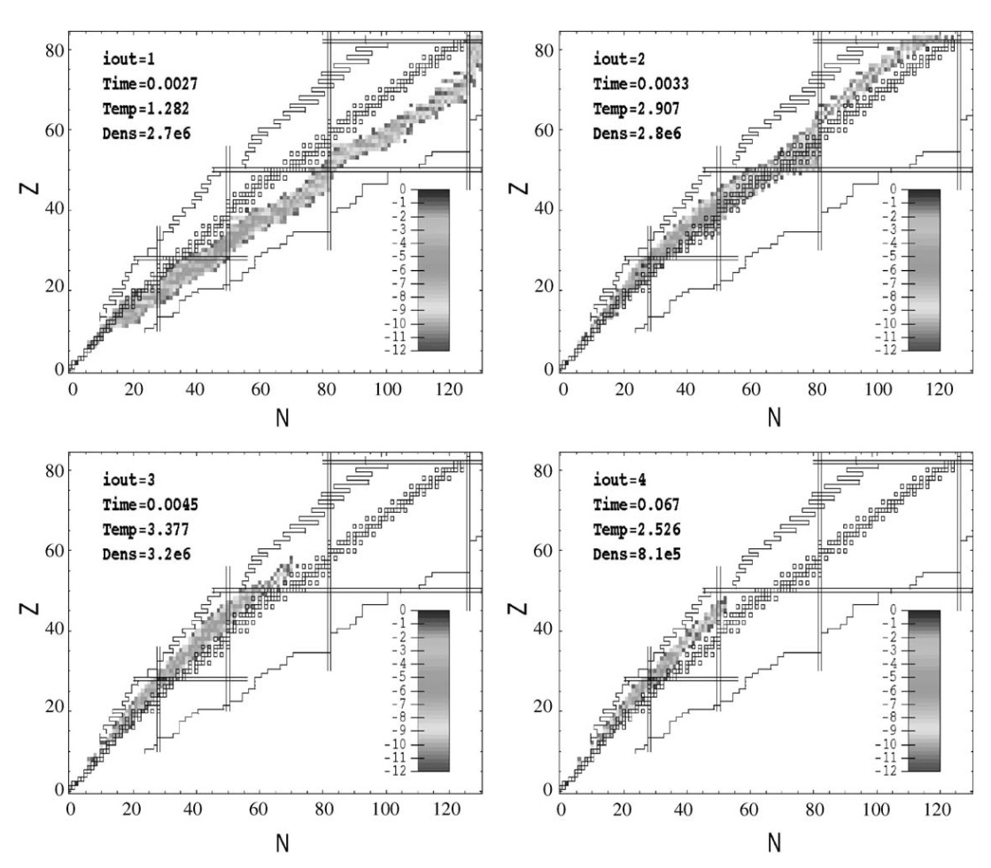
p-Synthesis in “canonical” SN Ia
and sub-Chandrasekhar WD explosions
Howard, Meyer, Woosley 1991
explosive burning of matter accreted from companion
high density, high proton density, high T
possibly combination of p captures and photodisintegration
may become initially neutron rich
possible seed enhancement by previous s-processing in AGB companion
large enhancement required
exact conditions unknown (multi-D)
Goriely et al 2002
Wallace & Woosley 1981
Howard, Meyer, Woosley 1991
Goriely et al 2002
Travaglio, Roepke et al 2010

Slide 19
Popular Scenarios
Currently “best” studied: γ-process in O/Ne shell of massive stars
consistent p-production across large range of nuclei
deficiencies for A<100 and 150<A<165
additional ν-process for ¹³⁸La and ¹⁸⁰Ta
Explosion of mass-accreting white dwarf
“regular” SN Ia and/or sub-Chandrasekhar WD
combination of p-captures and γ-process (and np-process)
Problems: requires seed enhancement, sensitive to details of the hydrodynamics
Extremely p-rich scenarios: rp-process, νp-process
decay of p-rich progenitors
problem: detailed modelling, ejection, ⁹²Nb in meteorites puts tight constraint

Slide 20
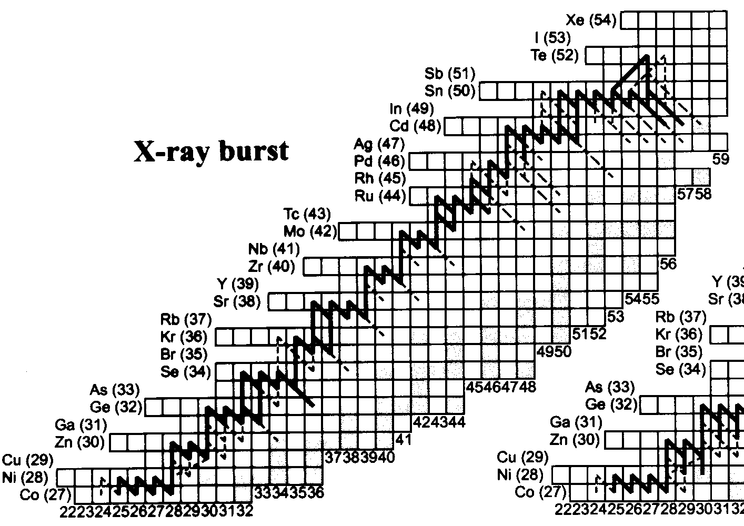
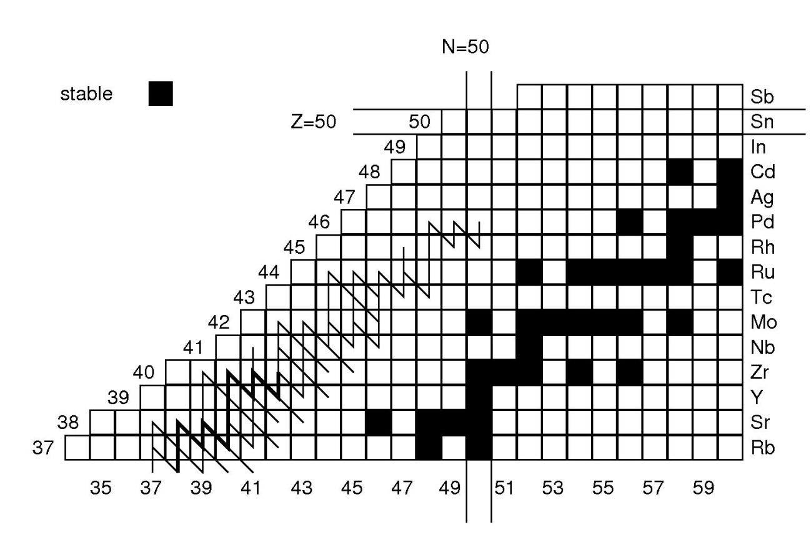
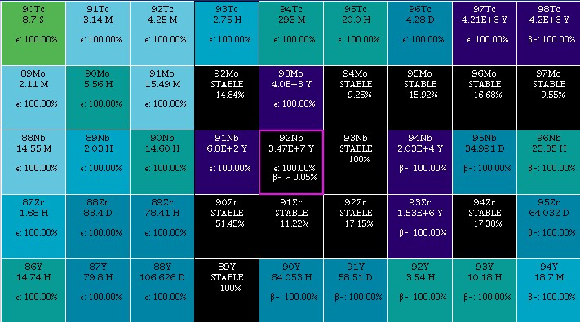
Schatz et al 1999
⁹²Nb cannot be reached by decays
Live ⁹²Nb found in presolar grains
tight constraint on contribution from p-rich side (Dauphas et al 2003)
νp-process
Pruet et all 2006; Fröhlich et al 2006; Weber et al 2009

Slide 21
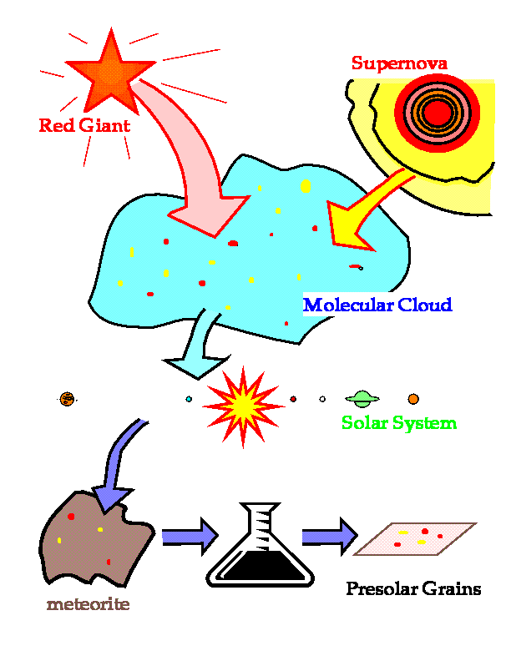
Meteorites allow us a hands-on study of stellar matter!
Two types of interesting
contributions to presolar cloud:
1. Presolar grains:
Each grain is from a single star!
Found in special types of
meteorites; allows isotopic analysis.
2. Extinct radioactivities:
Traces of long-lived radioactive
isotopes from stellar sources just before
freeze-out of pre-solar cloud;
extracted from bulk meteorites;
summed contributions from many stars.
Important information on p-nuclei:
Bulk SS values
Early SS values
Isotopic anomalies in grains and bulk
adapted from M. Lugaro

Slide 22
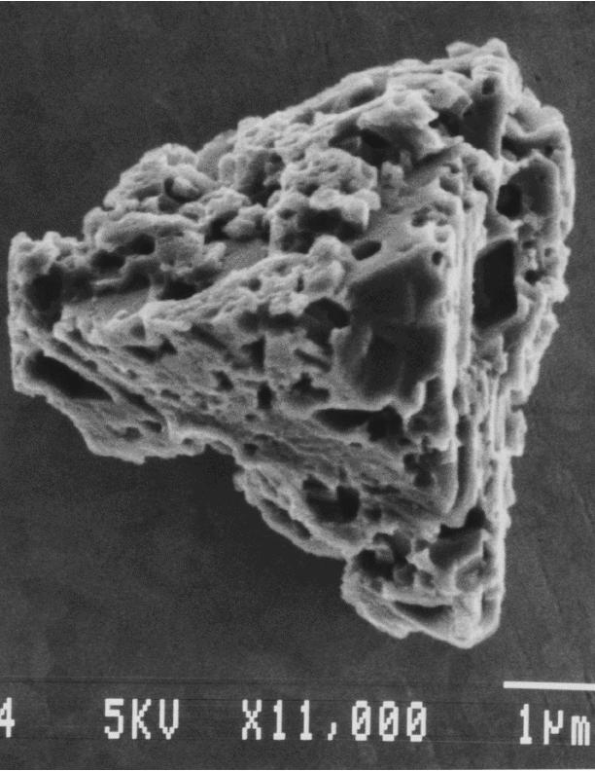
Meteoritic Grains
s process constraints: from meteoritic silicon carbide (SiC) grains that formed in the expanding envelopes of carbon stars (AGB) and contain trace amounts of heavy elements showing the signature of the s process.
Other types of grains formed in stellar wind from massive stars and in SN remnants
High-sensitivity laboratory measurements of the isotopic composition of trace heavy element in single grains of the size of micrometers provide constraints of precision never achieved before.

Slide 23
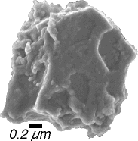
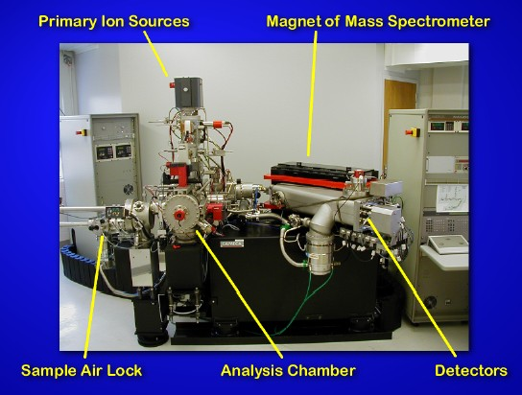
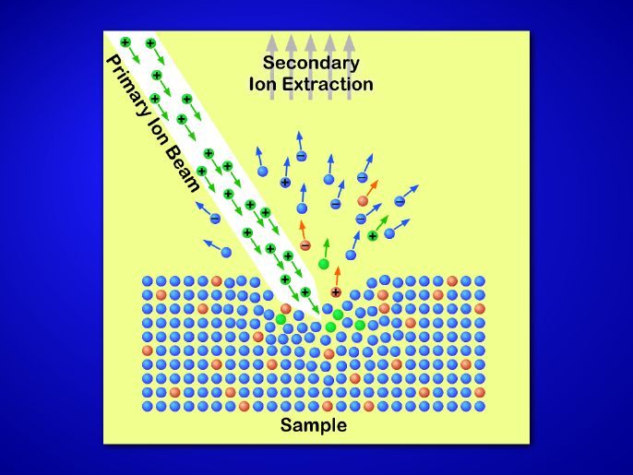
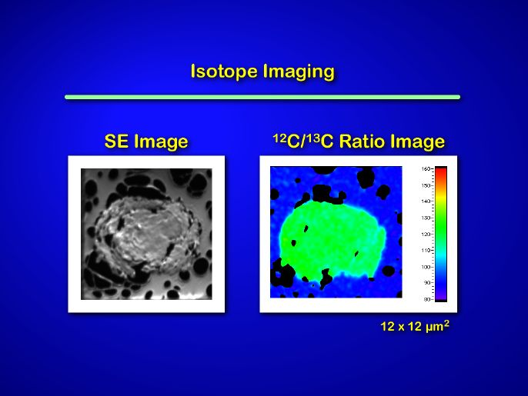
Analysis of presolar grains found in meteorites
SiC grain
NanoSIMS at Washington University, St. Louis
F.J. Stadermann, http://presolar.wustl.edu/nanosims/wks2003/index.html

Slide 24
Traces of decay products of long-lived but already extinct radionuclides
are preserved in meteorites containing untainted material from the early
solar system.
¹⁴⁶Sm

Slide 25
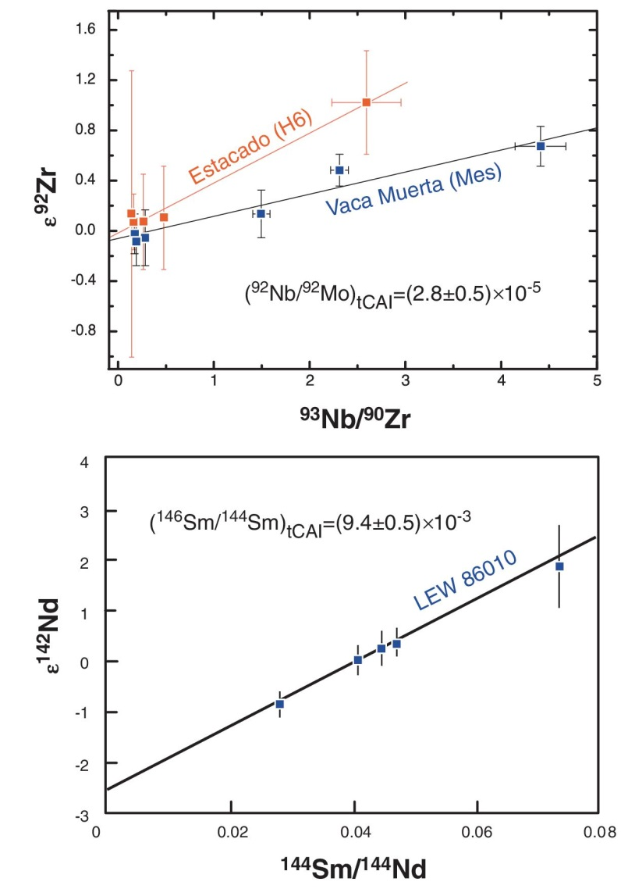
Extinct Radioactivities in Bulk Meteorites
Isochrone Definition:

Slide 26
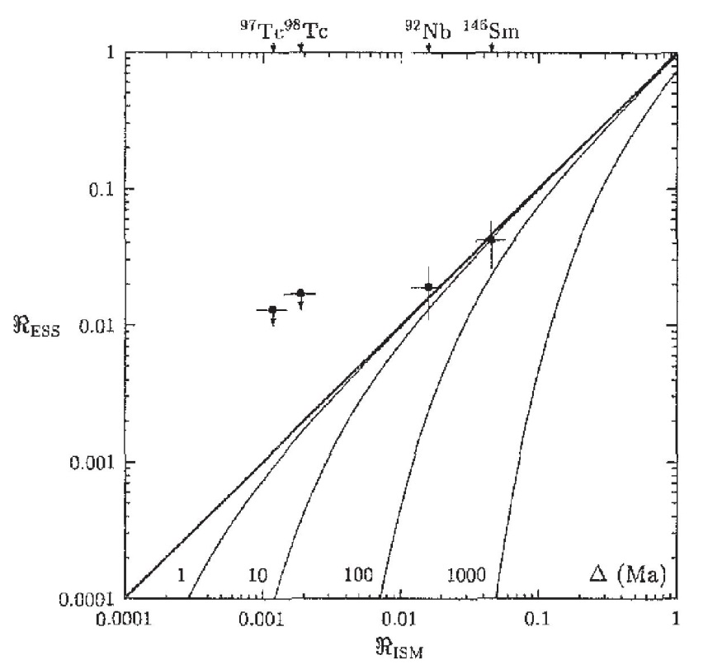
Open-Box GCE model:
3-phase ISM mixing model:
τ…half-life
Nb and Sm data are consistent and constrain the free parameter of the GCE model.
This excludes 92Mo contributions from processes not making 92Nb!
But: Based on current production ratios! Problem with 146/144Sm ratio?

Slide 27
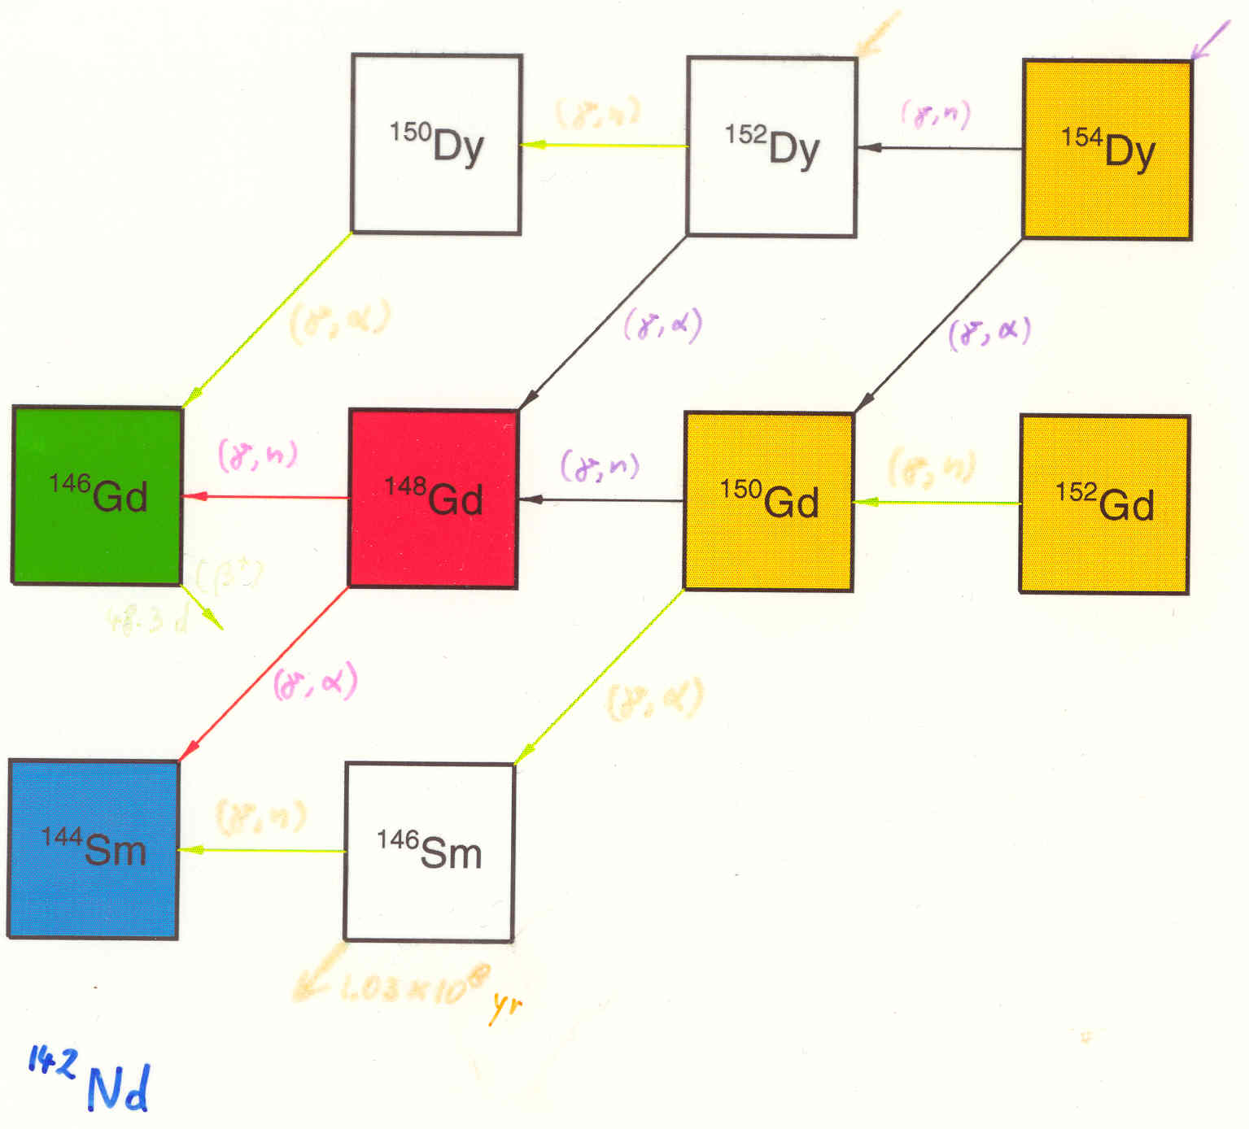
Network for Nd/Sm

Slide 28
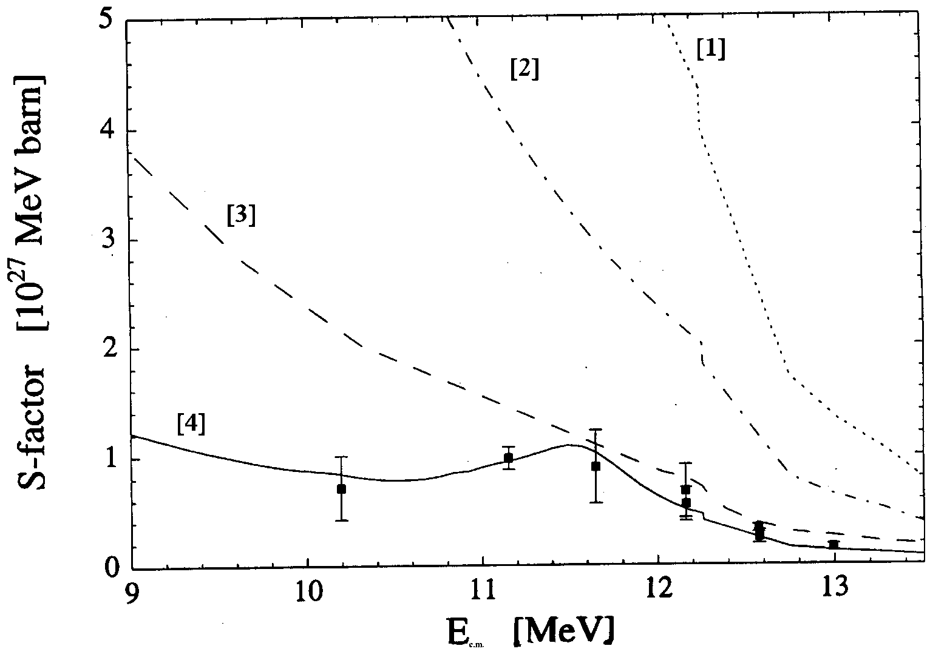
Problem with α+¹⁴⁴Sm Potential
[1] McFadden & Satchler Pot.
[2] Avrigeanu Pot. I
[3] Mohr & Rauscher 98 Pot.
[4]+exp: Somorjai et al. 1998
¹⁴⁴Sm(α,γ)¹⁴⁸Gd
Somorjai et al, A&A 333, 1112 (1998)

Slide 29
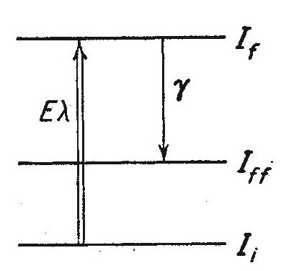
(Low energy) Coulomb excitation
compound inelastic
direct inelastic scattering
= Coulomb excitation
α'
α'
α
T. Rauscher, PRL 111 (2013) 061104
α
compound
elastic
α
Compound formation + reaction
direct elastic scattering
Direct elastic scattering is included in optical model calculation of compound formation
Direct inelastic is not included

Slide 30
Rates determining the 146/144Sm ratio
Production ratio inferred from meteorites: 0.2<=R<=0.23
Production ratio ¹⁴⁶Sm/¹⁴⁴Sm depends on ¹⁴⁸Gd(γ,n/α):
T. Rauscher, PRL 111 (2013) 061104
New ¹⁴⁸Gd(γ,α)¹⁴⁴Sm rate (code SMARAGD, McF&S potential) is factor of about 3 higher than Woosley & Howard (1991) rate.
New ¹⁴⁸Gd(γ,n) ¹⁴⁷Gd rate is about 0.56 of W&H'91.
Therefore, new ratio even lower than in W&H'91: 0.02
Crude estimate, still has to be checked in γ-process network calculation (T-dependence of rates)!

Slide 31
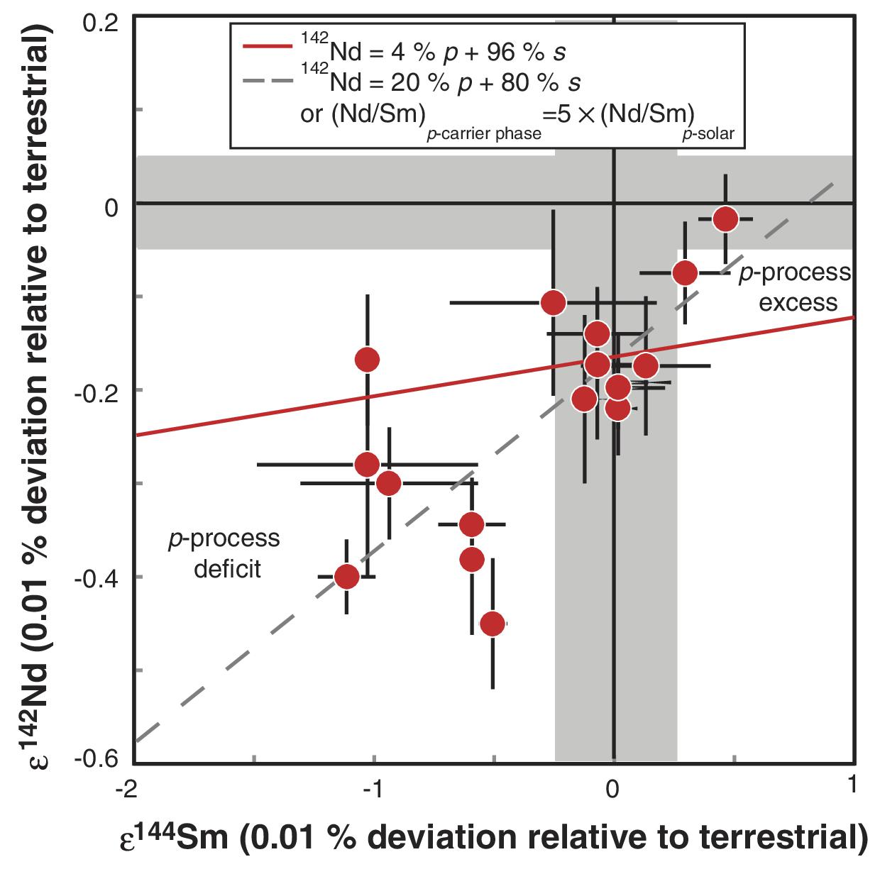
Correlation of ¹⁴⁴Sm Variation with ¹⁴²Nd Variation in Bulk Chondrites
20% γ-process contribution??
At odds with s-process predictions (142Nd is primarily s-process and perhaps even produced too much rather than too little).
Rep. Prog. Phys. 76 (2013) 066201
Such a large γ-process contribution is also at odds with other p-production and extinct radionuclides.

Slide 32
Origin of deficiencies in p-production?
Higher mass range:
(γ,n)/(γ,α) branchings important
large theoretical uncertainties in (γ,α) reactions at low energy
cure possible by improved nuclear physics?
Light p-nuclei:
(γ,n)/(γ,p) branchings important
better known? (possible problem with proton potential)
But: Already W&H78 noted that there is not enough (γ,n) photodisintegration seed
Enhanced feeding from “above”?
Different seed abundances? (weak s-process, ²²Ne+α)
Different site/process? (νp-process, SN Ia, sub-Chandra WD?)
More data and improved reaction rates needed!
More detailed astrophysical models needed!

Slide 33
Conclusions to take home
Origin of elements beyond Fe still challenging
Direct and inverse approaches are complementary, both required in nucleosynthesis studies
direct: “full” models
inverse: infer conditions from abundances and postprocessing with varying conditions
Synthesis of p-nuclei complicated
considerable nuclear physics uncertainties
different processes may contribute to different regions
ccSN (+ νp-process?), SNIa, X-ray bursters?
constraints and hints from abundances
metal-poor stars (elemental ab.), presolar meteoritic grains (isotopic ab., late stars)
Good example for necessary interaction between different fields
astrophysical modelling, nuclear theory + experiment, observations
cosmochemistry
GCE (Galactic Chemical Evolution) models

Slide 34
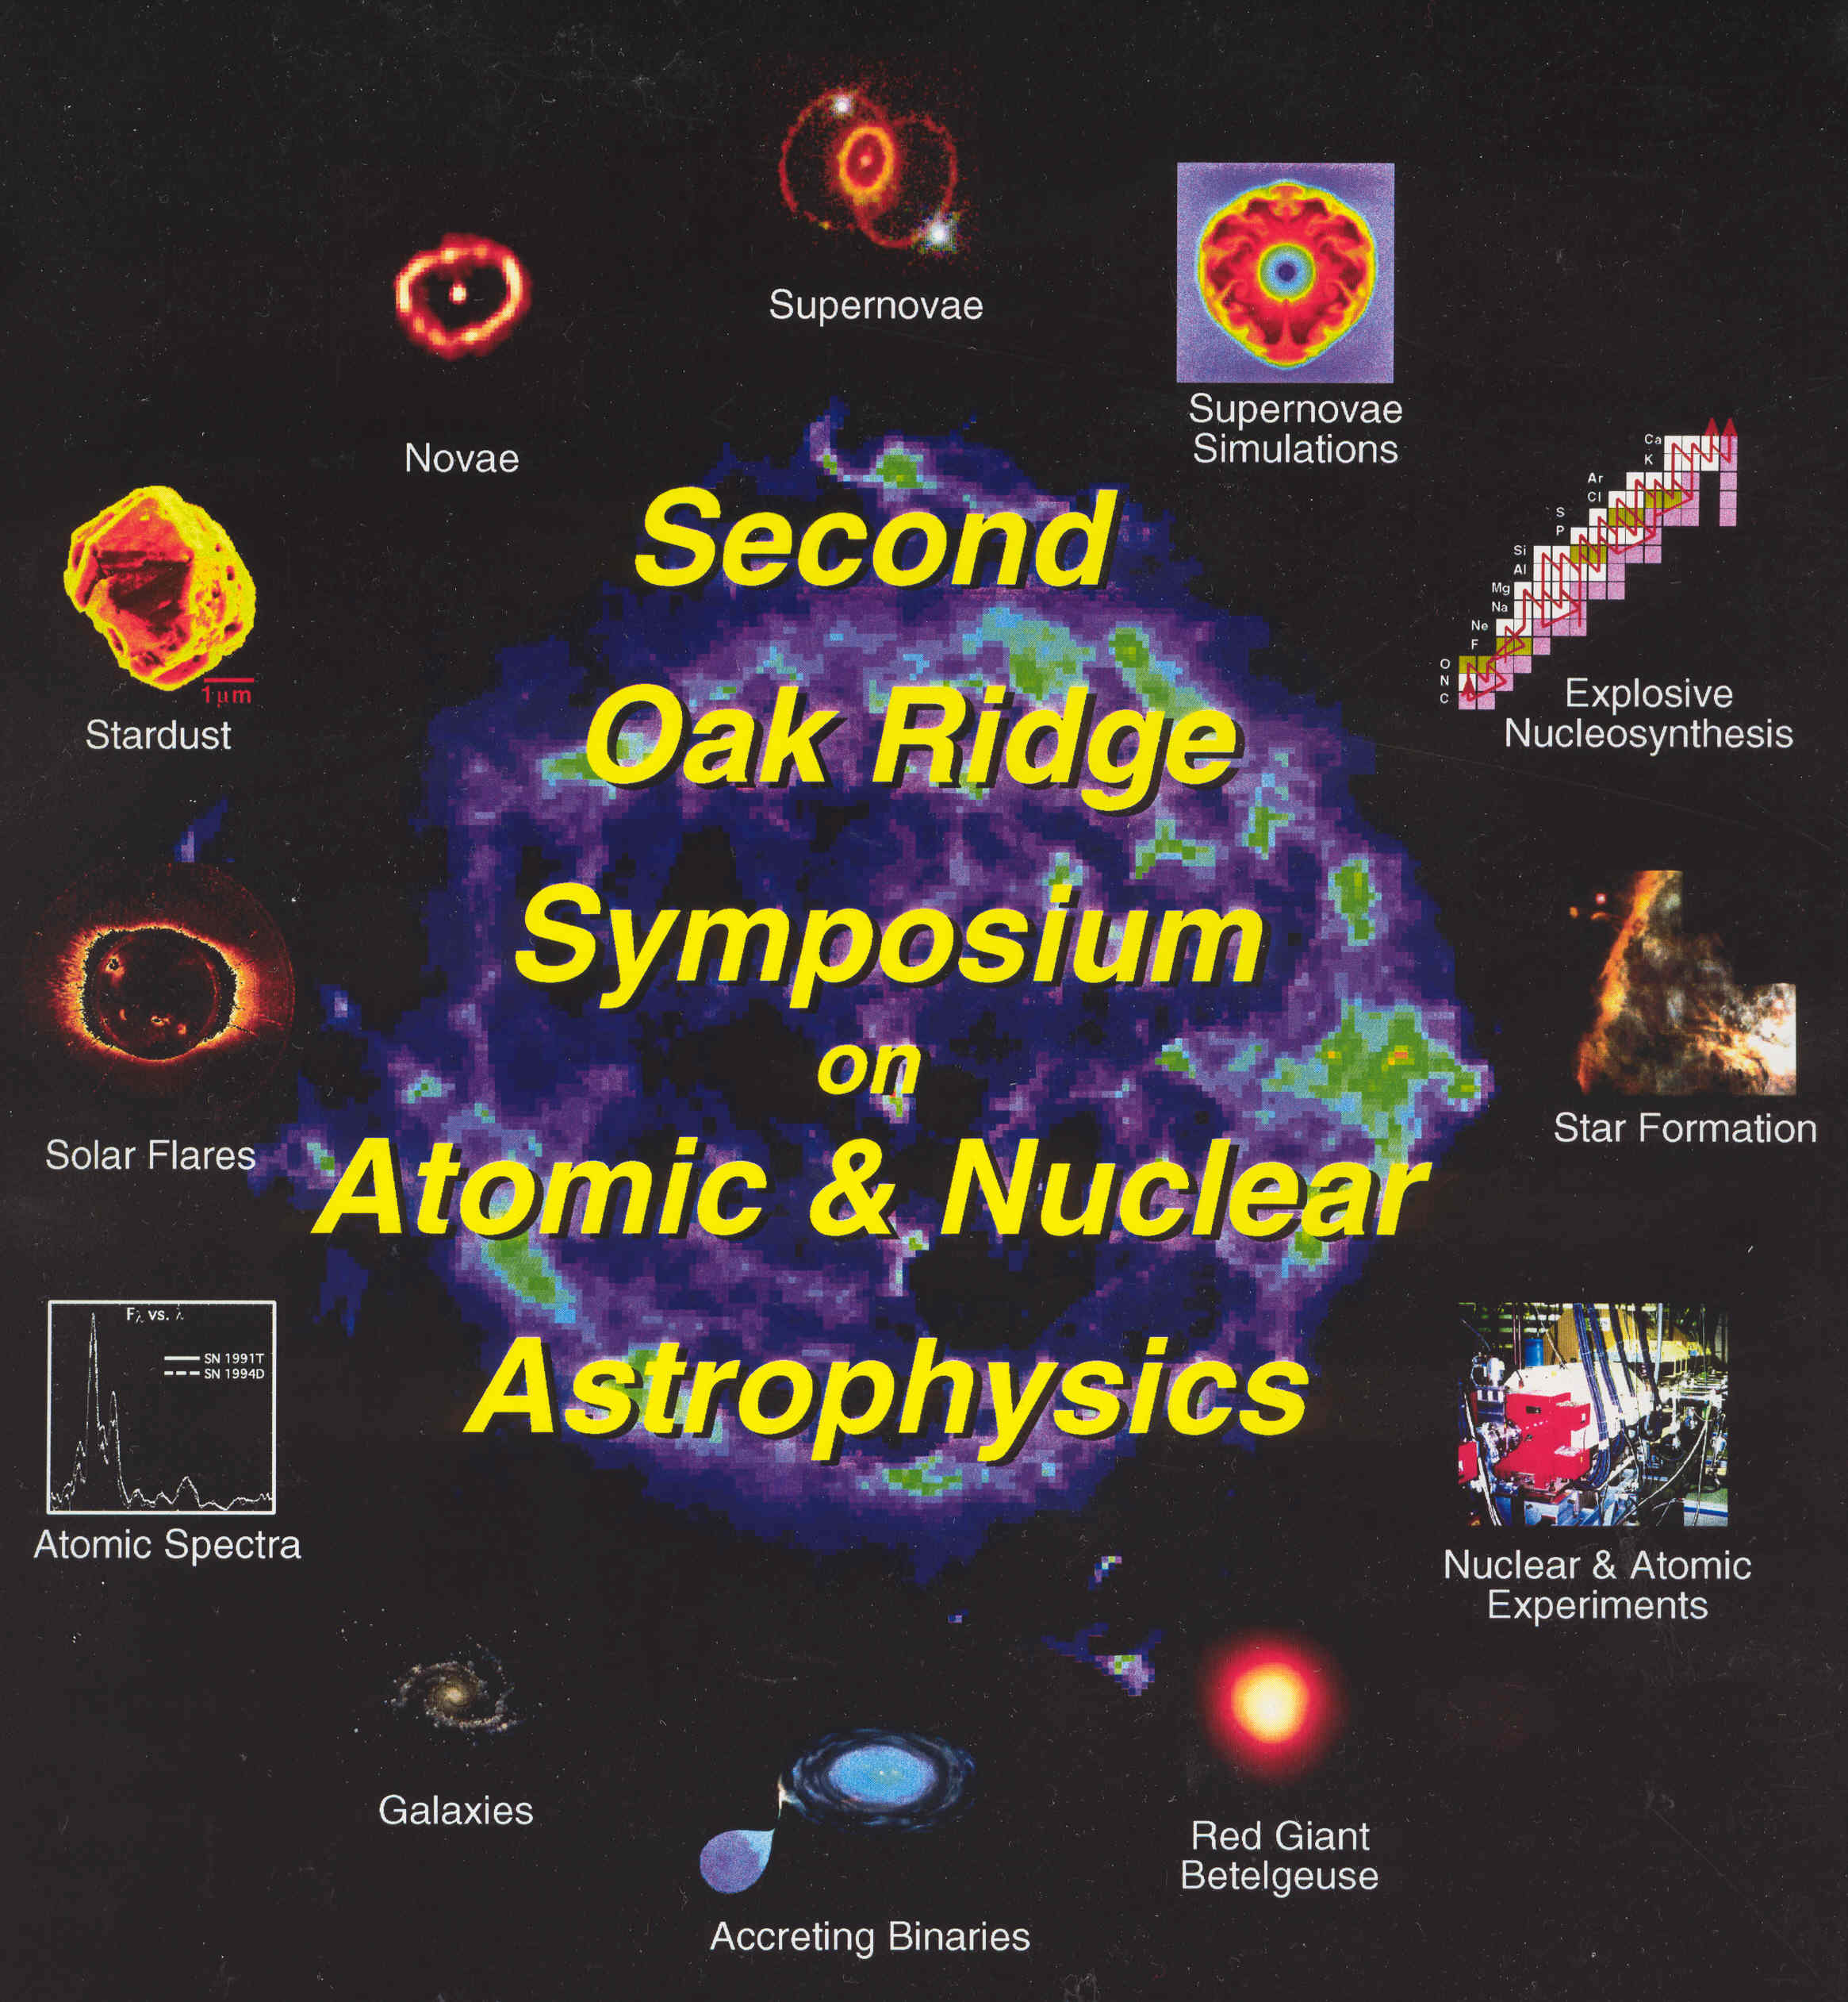
Thank you for your attention!

